Slide 1
Bayesian Network
Il-Chul Moon Dept. of Industrial and Systems Engineering KAIST
icmoon@kaist.ac.kr

Slide 2
Weekly Objectives
Know and memorize the theorems of probability
Recover the probability concepts
Recover the probability theorems
Recover the concepts of the marginal and the conditional independencies
Understand Bayesian networks
Know the syntax and the semantics of Bayesian networks
Know how to factorize Bayesian networks
Able to calculate a probability with given conditions
Understand the inference of Bayesian networks
Able to calculate parameters of Bayesian networks
Able to list the exact inference of Bayesian networks

Slide 3
Recap on Probability

Slide 4
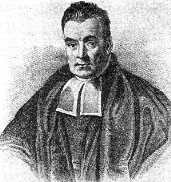
Probabilities
We will write P(A = true) to mean the probability that A = true.
What is probability?
It is the relative frequency with which an outcome would be obtained if the process were repeated a large number of times under similar conditions*
The sum of the red and blue areas is 1
P(A = true)
正 正
P(A = false)
正 正 正 正
*Ahem…there’s also the Bayesian definition which says probability is your degree of belief in an outcome

Slide 5
Conditional Probability
P(A = true | B = true)
Out of all the outcomes in which B is true, how many also have A equal to true
Read this as:
“Probability of A conditioned on B” or “Probability of A given B”
H = “Have a headache”
F = “Coming down with Flu”
P(H = true) = 1/10
P(F = true) = 1/40
P(H = true | F = true) = 1/2
“Headaches are rare and flu is rarer, but if you’re coming down with flu there’s a 50-50 chance you’ll have a headache.”
감기 (F)
두통 (H)

Slide 6
Joint Probability
We will write P(A = true, B = true) to mean
the probability of A = true and B = true
P(H=true|F=true)
P(F = true)
P(H = true)
In general, P(X|Y)=P(X,Y)/P(Y)

Slide 7
Computing with Probabilities: Law of Total Probability
Law of Total Probability
a.k.a “summing out” or marginalization
P(a) = ∑_{b}P(a, b) = ∑_{b}P(a | b) P(b)
When B is any random variable
Consider this case
given a joint distribution (e.g., P(a,b,c,d))
We can obtain any “marginal” probability (e.g., P(b)) by summing out the other variables
P(b) = ∑_{a}∑_{c}∑_{d}P(a, b, c, d)
Also, consider this case
given a joint distribution (e.g., P(a,b,c,d))
We can obtain any conditional probability of interest
P(c | b) = ∑_{a}∑_{d}P(a, c, d | b)=1/P(b)∑_{a}∑_{d}P(a, c, d, b)
Where 1 / P(b) is just a normalization constant
Joint distribution contains the information we need to compute any probability of interest.

Slide 8
Computing with Probabilities: Chain Rule or Factorization
We can always write
P(a, b, c, … z) = P(a | b, c, …. z) P(b, c, … z)
by definition of joint probability
Repeatedly applying this idea, we can write
P(a, b, c, … z) = P(a | b, c, …. z) P(b | c,.. z) P(c| .. z)..P(z)
This factorization holds for any ordering of the variables
Chain rule for probabilities
Any joint probability → Can be factorized into a series of multiplication

Slide 9
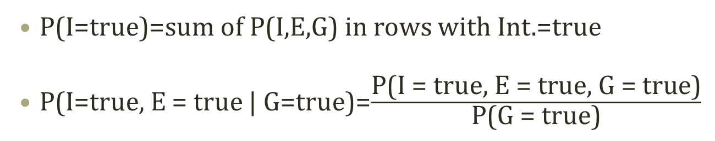
Joint Probability Distribution
Joint probabilities can be between any number of variables
P(Int = true, Effort = true, GPA = true)
For each combination of variables, we need to say how probable that combination is
The probabilities of these combinations need to sum to 1
Int. | Effort | GPA | P(I,E,G)
false | false | false | 0.1
false | false | true | 0.2
false | true | false | 0.05
false | true | true | 0.05
true | false | false | 0.3
true | false | true | 0.1
true | true | false | 0.05
true | true | true | 0.15
P(I=true)=sum of P(I,E,G) in rows with Int.=true
P(I=true, E = true | G=true)=$\frac{\text{P}\text{(}\text{I}\text{ = }\text{true}\text{, }\text{E}\text{ = }\text{true}\text{, }\text{G}\text{ = }\text{true}\text{)}}{\text{P}\text{(}\text{G}\text{ = }\text{true}\text{)}}$
Sums to 1
Any problem in this statistical model?

Slide 10
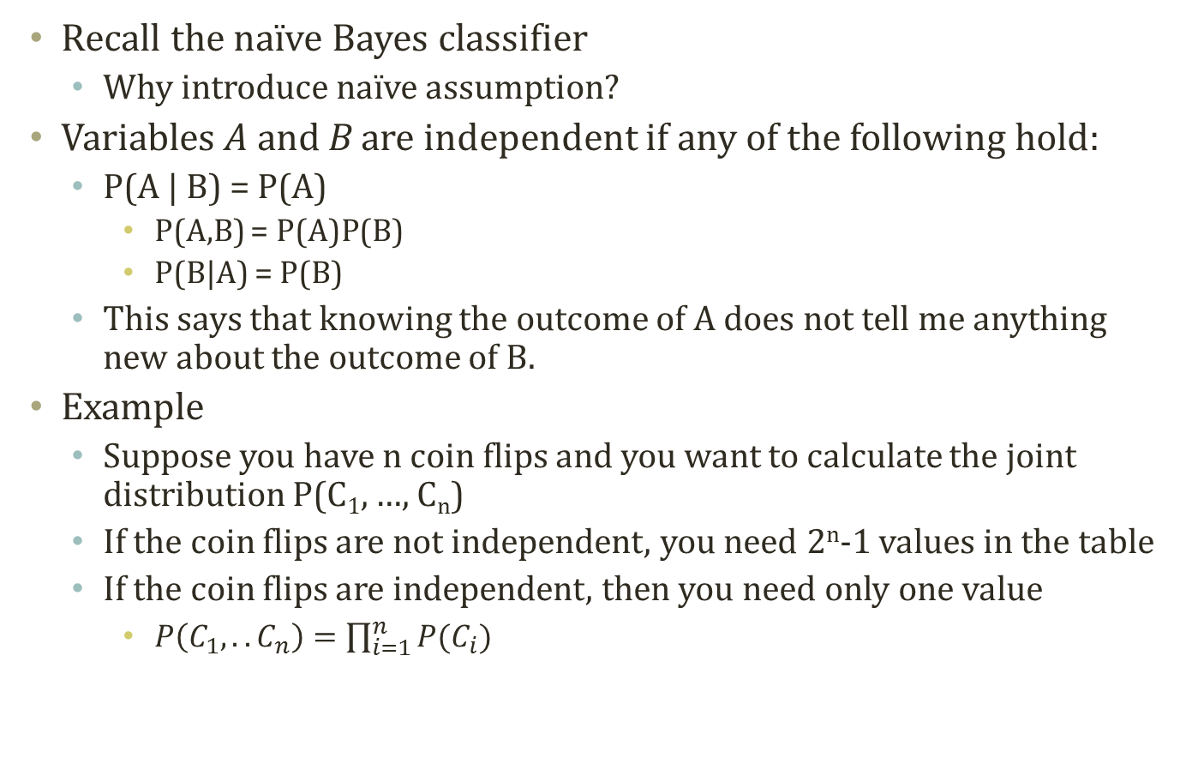
Independence
Recall the naïve Bayes classifier
Why introduce naïve assumption?
Variables A and B are independent if any of the following hold:
P(A | B) = P(A)
P(A,B) = P(A)P(B)
P(B|A) = P(B)
This says that knowing the outcome of A does not tell me anything new about the outcome of B.
Example
Suppose you have n coin flips and you want to calculate the joint distribution P(C₁, …, C_{n})
If the coin flips are not independent, you need 2^{n}-1 values in the table
If the coin flips are independent, then you need only one value
$P\left(C_{1},..C_{n}\right)=\prod_{i=1}^{n}{P(C_{i})}$

Slide 11

Conditional vs. Marginal Independence
전진하라!
전진하라?
사령관
전진하라?
군인 A
군인 B
Marginal independence
P(OfficerA=Go|OfficerB=Go) > P(OfficerA=Go)
This is not marginally independent!
X and Y are independent if and only if P(X)=P(X|Y)
Consequently, P(X,Y)=P(X)P(Y)
Conditional independence
P(OfficerA=Go|OfficerB=Go,Commander=Go) =P(OfficerA=Go|Commander=Go)
This is conditionally independent!

Slide 12
Bayesian network

Slide 13
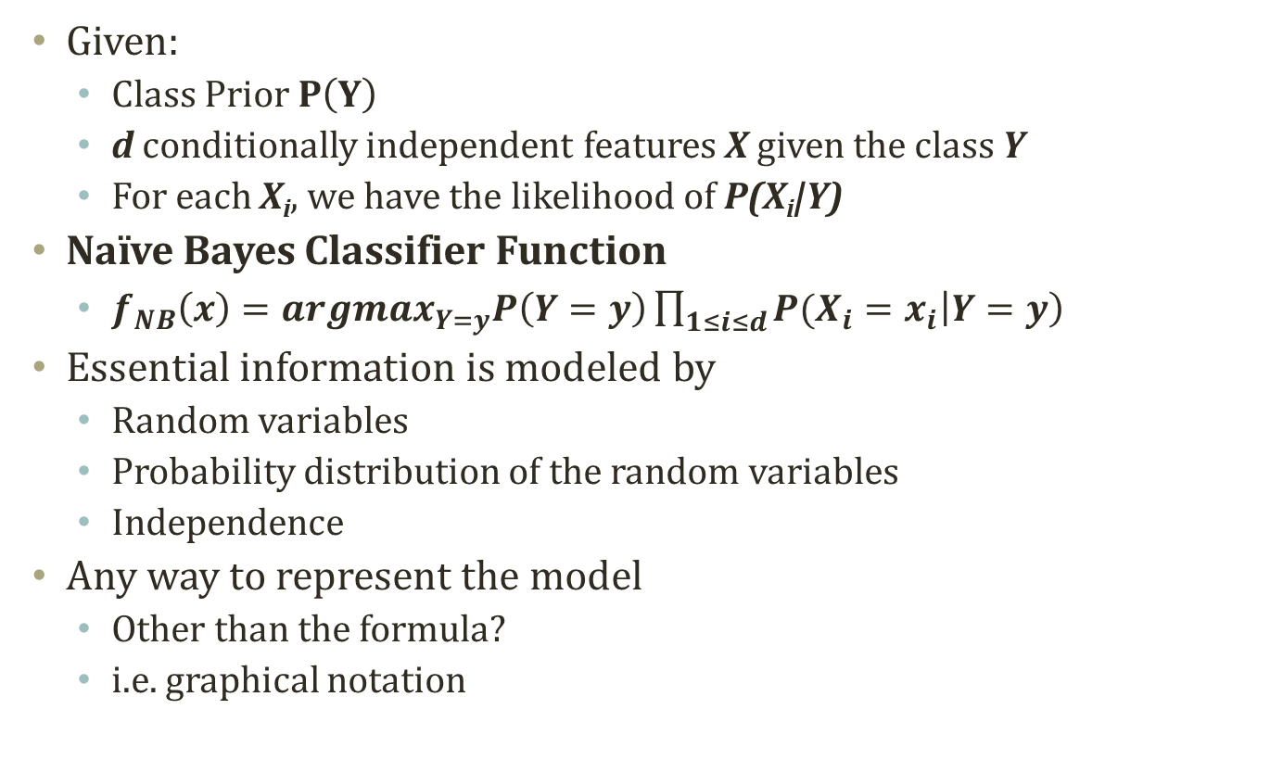
Detour: Naïve Bayes Classifier
Given:
Class Prior $P\left(Y\right)$
d conditionally independent features X given the class Y
For each X_{i}, we have the likelihood of P(X_{i}|Y)
Naïve Bayes Classifier Function
$f_{NB}\left(x\right)={argmax}_{Y=y}P\left(Y=y\right)\prod_{1≤i≤d}{P(X_{i}=x_{i}\left|Y=y\right)}$
Essential information is modeled by
Random variables
Probability distribution of the random variables
Independence
Any way to represent the model
Other than the formula?
i.e. graphical notation
Y
X₁
X₂
Z
Y
X

Slide 14
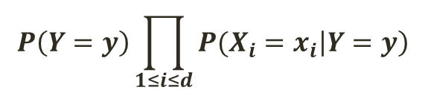
Bayesian Network
$$P\left(Y=y\right)\prod_{1≤i≤d}{P(X_{i}=x_{i}\left|Y=y\right)}$$
A graphical notation of
Random variables
Conditional independence
To obtain a compact representation of the full joint distributions
Syntax
A acyclic and directed graph
A set of nodes
A random variable
A conditional distribution given its parents
P (X_{i}|Parents(X_{i}))
A set of links
Direct influence from the parent to the child
Graphical Representation
P(Y|Φ)
Y
X₁
X₂
P(X₁|Y)
P(X₂|Y)

Slide 15
Interpretation of Bayesian Network
Topology of network encodes conditional independence assertions
Often from the domain experts
What is related to what and how
Interpretation
Weather is independent of the other variables
Toothache and Stench are conditionally independent given Cavity
Cavity influences the probability of toothache and stench
나이
날씨
충치
치통
악취

Slide 16
Another Example
P(B)=0.001
P(E)=0.002
도둑 (B)
지진 (E)
Scenario
I'm at work
Neighbor John calls to say my alarm is ringing
Neighbor Mary doesn't call.
Sometimes it's set off by minor earthquakes.
Is there a burglar?
Variables
Burglary, Earthquake, Alarm, JohnCalls, MaryCalls
Network topology reflects "causal" knowledge:
A burglar can set the alarm off
An earthquake can set the alarm off
The alarm can cause Mary to call
The alarm can cause John to call
알람 (A)
존 (J)
메리 (M)
A | P(J|A)
T | 0.90
F | 0.05
B | E | P(A|B,E)
T | T | 0.95
T | F | 0.94
F | T | 0.29
F | F | 0.001
A | P(M|A)
T | 0.70
F | 0.01

Slide 17
Components of Bayesian Network
P(B)=0.001
P(E)=0.002
Buglary
Earthquake
Qualitative components
Prior knowledge of causal relations
Learning from data
Frequently used structures
Structural aspects
Quantitative components
Conditional probability tables
Probability distribution assigned to nodes
Probability computing is related to both
Quantitative and Qualitative
Alarm
JohnCalls
MaryCalls
A | P(J|A)
T | 0.90
F | 0.05
B | E | P(A|B,E)
T | T | 0.95
T | F | 0.94
F | T | 0.29
F | F | 0.001
A | P(M|A)
T | 0.70
F | 0.01

Slide 18
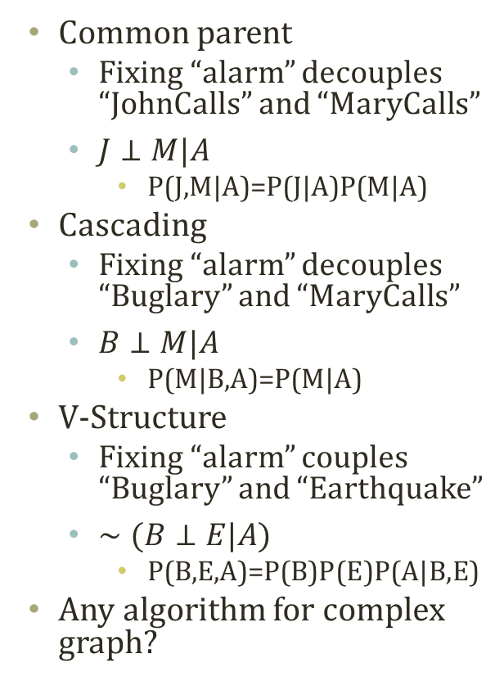
Typical Local Structures
P(A,B)=P(A)P(B)
P(A|B)=P(A)
Alarm
Common parent
Fixing “alarm” decouples “JohnCalls” and “MaryCalls”
$J⊥M|A$
P(J,M|A)=P(J|A)P(M|A)
Cascading
Fixing “alarm” decouples “Buglary” and “MaryCalls”
$B⊥M|A$
P(M|B,A)=P(M|A)
V-Structure
Fixing “alarm” couples “Buglary” and “Earthquake”
$∼(B⊥E|A)$
P(B,E,A)=P(B)P(E)P(A|B,E)
Any algorithm for complex graph?
JohnCalls
MaryCalls
Common Parent
도둑 (B)
알람 (A)
메리 (M)
Cascading
Buglary
Earthquake
Alarm
V-Structure

Slide 19
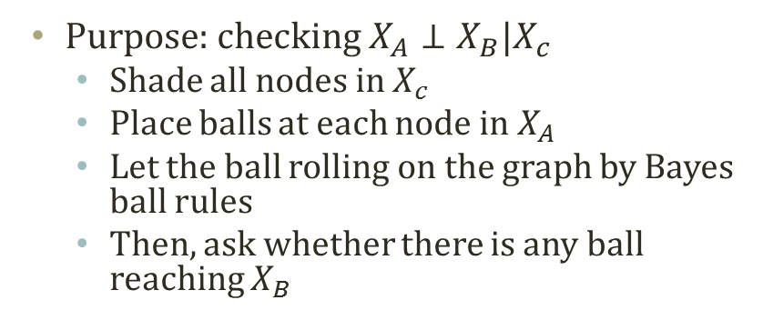
Bayes Ball Algorithm
Purpose: checking $X_{A}⊥X_{B}|X_{c}$
Shade all nodes in $X_{c}$
Place balls at each node in $X_{A}$
Let the ball rolling on the graph by Bayes ball rules
Then, ask whether there is any ball reaching $X_{B}$

Slide 20
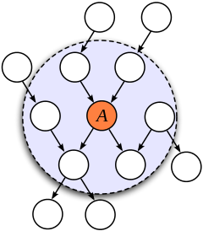
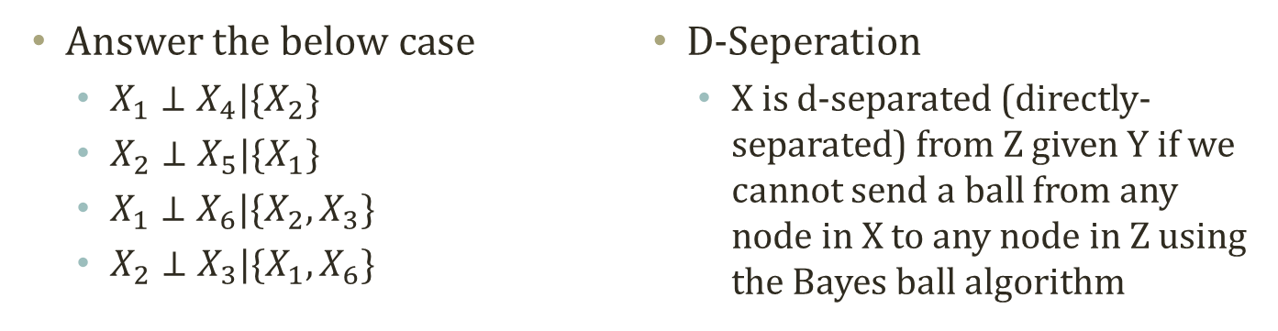
Exercise of Bayes Ball Algorithm
X4
Markov Blanket
P(A|blanket, B)=P(A|blanket)
Blanket={parents, children, children’s other parents}
X2
X1
X6
X3
X5
Answer the below case
$X_{1}⊥X_{4}|\{X_{2}\}$
$X_{2}⊥X_{5}|\{X_{1}\}$
$X_{1}⊥X_{6}|\{X_{2},X_{3}\}$
$X_{2}⊥X_{3}|\{X_{1},X_{6}\}$
D-Seperation
X is d-separated (directly-separated) from Z given Y if we cannot send a ball from any node in X to any node in Z using the Bayes ball algorithm

Slide 21
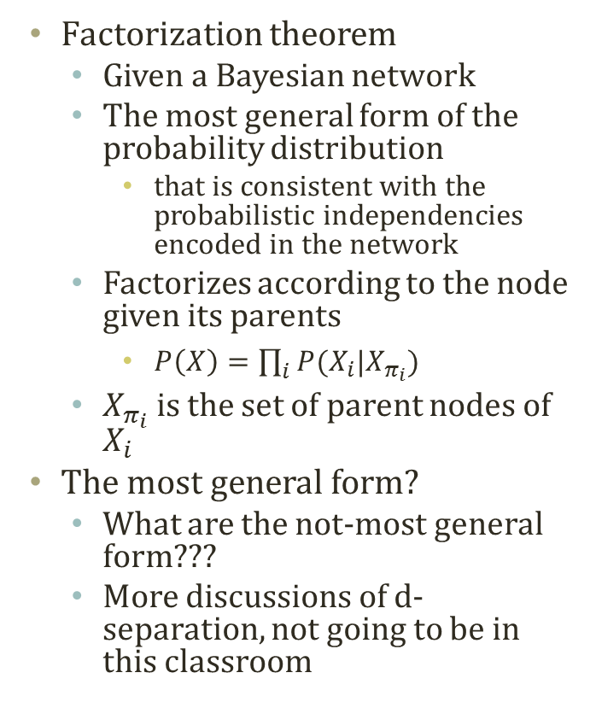
Factorization of Bayesian Network
Factorization theorem
Given a Bayesian network
The most general form of the probability distribution
that is consistent with the probabilistic independencies encoded in the network
Factorizes according to the node given its parents
$P\left(X\right)=\prod_{i}{P(X_{i}|X_{π_{i}})}$
$X_{π_{i}}$ is the set of parent nodes of $X_{i}$
The most general form?
What are the not-most general form???
More discussions of d-separation, not going to be in this classroom
X1
X2
X3
X4
X5
X6
X7
X8
P(X1,X2,X3,X4,X5,X6,X7,X8)
=P(X1)P(X2)P(X3|X1)P(X4|X2)P(X5|X2)
P(X6|X3,X4)P(X7|X6)P(X8|X5,X6)

Slide 22



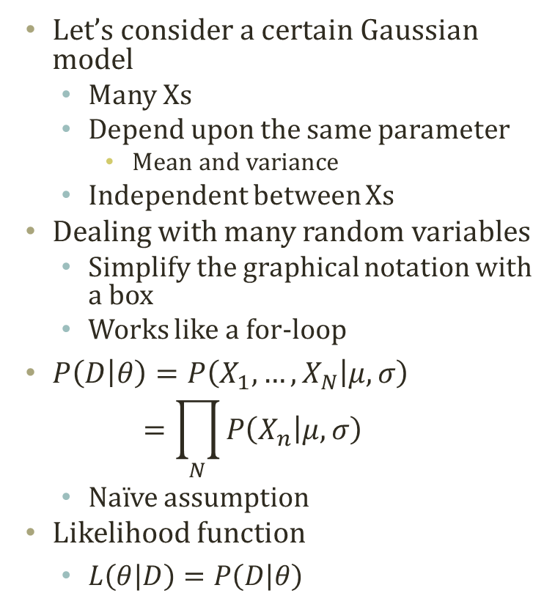


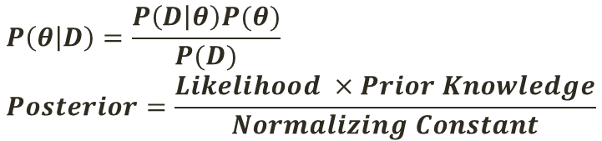


Plate Notation
$$P\left(θ | D\right)=\frac{P\left(D | θ\right)P(θ)}{P(D)} \\ Posterior=\frac{Likelihood ×Prior Knowledge}{Normalizing Constant}$$
$$μ$$
$$σ$$
$$μ$$
$$σ$$
Let’s consider a certain Gaussian model
Many Xs
Depend upon the same parameter
Mean and variance
Independent between Xs
Dealing with many random variables
Simplify the graphical notation with a box
Works like a for-loop
$P\left(D | θ\right)=P\left(X_{1},…,X_{N} | μ,σ\right)$ $=\prod_{N}{P\left(X_{n} | μ,σ\right)}$
Naïve assumption
Likelihood function
$L\left(θ | D\right)=P\left(D | θ\right)$
$$X_{i}$$
$$X_{1}$$
………..
$$X_{N}$$
i=1..N

Slide 23
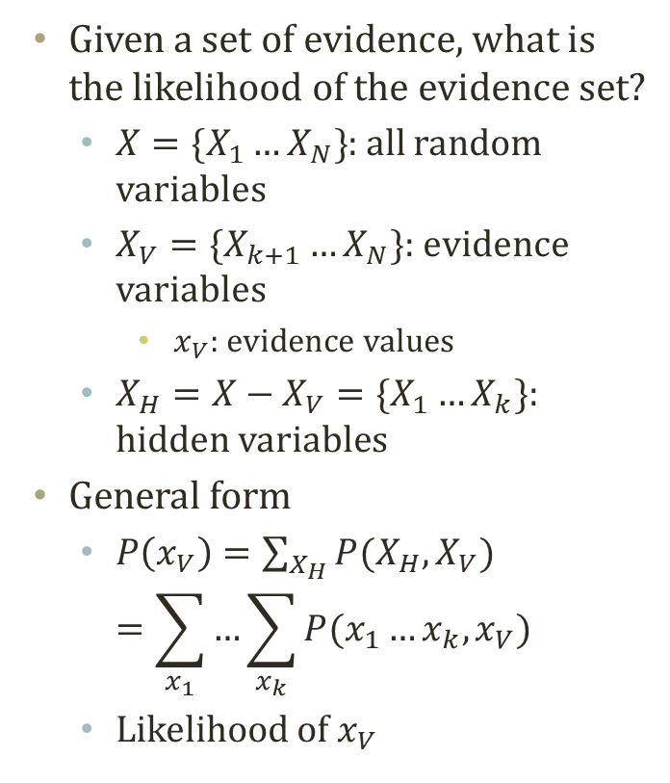
Inference Question 1: Likelihood
P(B=true, MC=true)=?
P(B)=0.001
P(E)=0.002
Buglary
Earthquake
Given a set of evidence, what is the likelihood of the evidence set?
$X=\{X_{1}…X_{N}\}$: all random variables
$X_{V}=\{X_{k+1}…X_{N}\}$: evidence variables
$x_{V}$: evidence values
$X_{H}=X−X_{V}=\{X_{1}…X_{k}\}$: hidden variables
General form
$P\left(x_{V}\right)=\sum_{X_{H}}{P(X_{H},X_{V})}$ $=\sum_{x_{1}}{…\sum_{x_{k}}{P(x_{1}…x_{k},x_{V})}}$
Likelihood of $x_{V}$
Alarm
JohnCalls
MaryCalls
A | P(J|A)
T | 0.90
F | 0.05
B | E | P(A|B,E)
T | T | 0.95
T | F | 0.94
F | T | 0.29
F | F | 0.001
A | P(M|A)
T | 0.70
F | 0.01

Slide 24
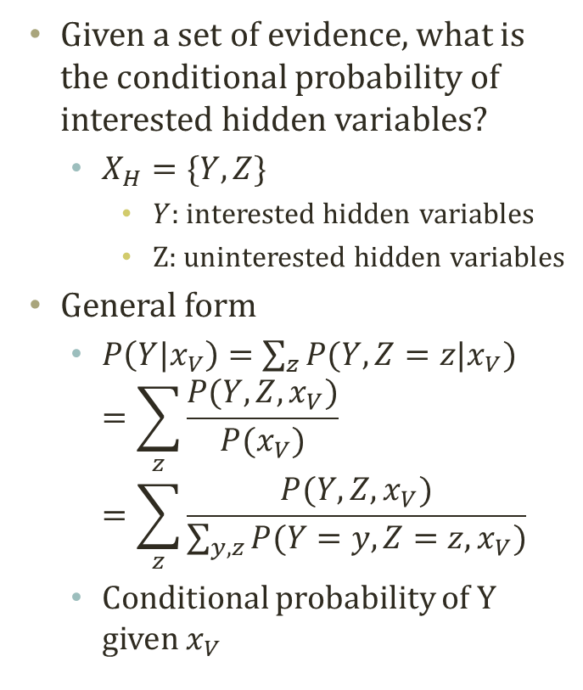
Inference Question 2: Conditional Probability
P(A|B=true, MC=true)=?
P(B)=0.001
P(E)=0.002
Buglary
Earthquake
Given a set of evidence, what is the conditional probability of interested hidden variables?
$X_{H}=\{Y,Z\}$
$Y$: interested hidden variables
Z: uninterested hidden variables
General form
$P\left(Y|x_{V}\right)=\sum_{z}{P(Y,Z=z|x_{V})}$ $=\sum_{z}{\frac{P(Y,Z,x_{V})}{P(x_{V})}}=\sum_{z}{\frac{P(Y,Z,x_{V})}{\sum_{y,z}{P(Y=y,Z=z,x_{V})}}}$
Conditional probability of Y given $x_{V}$
Alarm
JohnCalls
MaryCalls
A | P(J|A)
T | 0.90
F | 0.05
B | E | P(A|B,E)
T | T | 0.95
T | F | 0.94
F | T | 0.29
F | F | 0.001
A | P(M|A)
T | 0.70
F | 0.01

Slide 25
Inference Question 3: Most Probable Assignment
argmax_{a}P(A|B=true, MC=true)=?
P(B)=0.001
P(E)=0.002
Buglary
Earthquake
Given a set of evidence, what is the most probable assignment, or explanation, given the evidence?
Some variables of interests
Need to utilize the inference question 2
Conditional probability
Maximum a posteriori configuration of Y
Applications of a posteriori
Prediction
B, E → A
Diagnosis
A → B, E
Alarm
JohnCalls
MaryCalls
A | P(J|A)
T | 0.90
F | 0.05
B | E | P(A|B,E)
T | T | 0.95
T | F | 0.94
F | T | 0.29
F | F | 0.001
A | P(M|A)
T | 0.70
F | 0.01

Slide 26
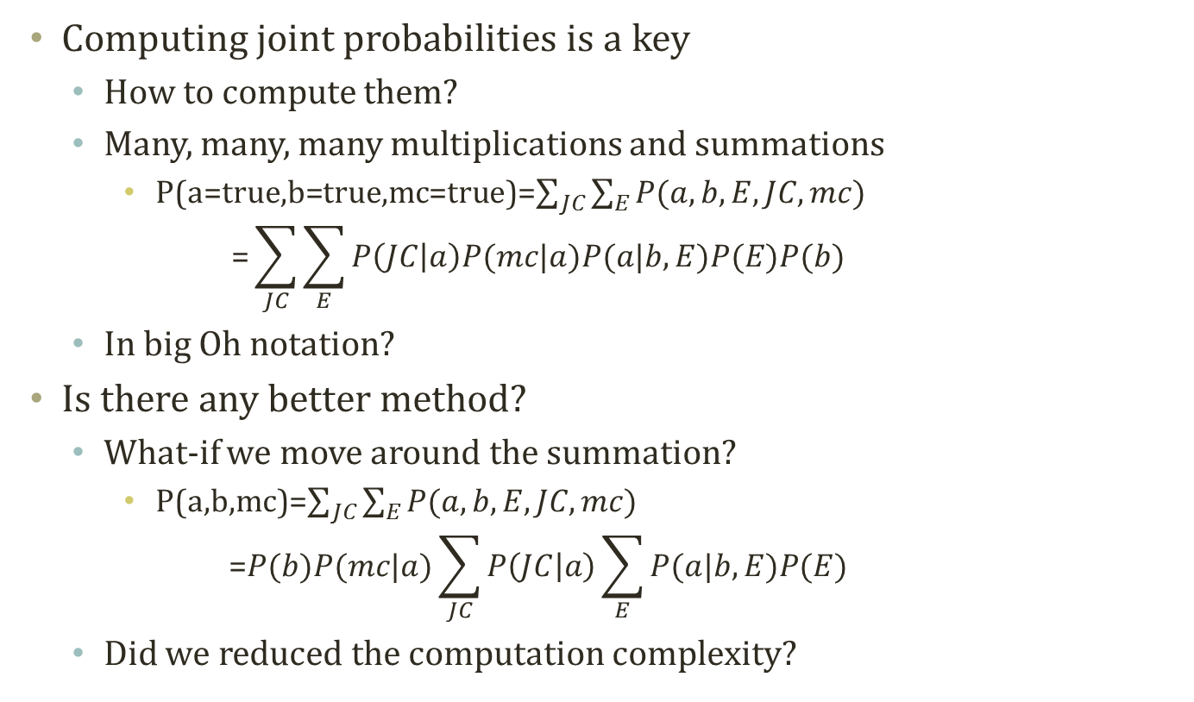
Marginalization and Elimination
B
E
Computing joint probabilities is a key
How to compute them?
Many, many, many multiplications and summations
P(a=true,b=true,mc=true)=$\sum_{JC}{\sum_{E}{P(a,b,E,JC,mc)}}$ $\text{=}\sum_{JC}{\sum_{E}{P\left(JC | a\right)P(mc|a)P(a|b,E)P(E)P(b) }}$
In big Oh notation?
Is there any better method?
What-if we move around the summation?
P(a,b,mc)=$\sum_{JC}{\sum_{E}{P(a,b,E,JC,mc)}}$ $\text{=}P(b)P(mc|a)\sum_{JC}{P\left(JC | a\right)\sum_{E}{P(a|b,E)P(E) }}$
Did we reduced the computation complexity?
A
JC
MC
P(E)=0.002
P(B)=0.001
A | P(J|A)
T | 0.90
F | 0.05
B | E | P(A|B,E)
T | T | 0.95
T | F | 0.94
F | T | 0.29
F | F | 0.001
A | P(M|A)
T | 0.70
F | 0.01

Slide 27
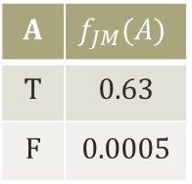
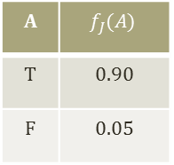
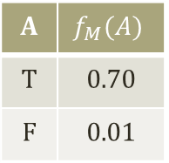
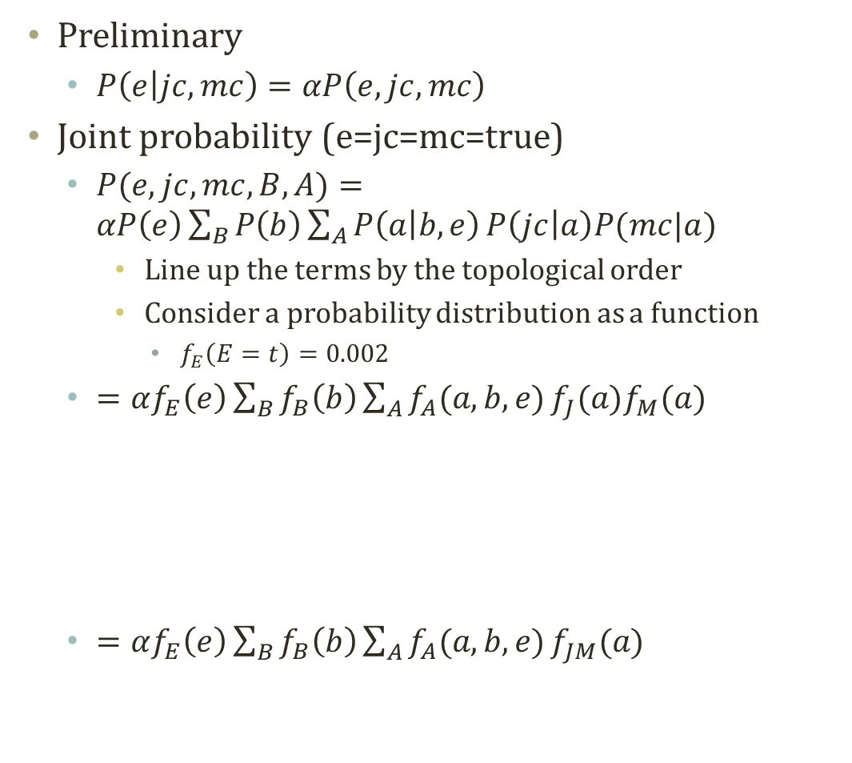
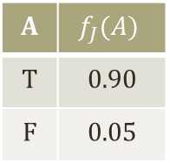
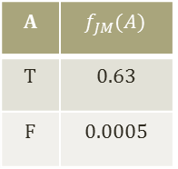
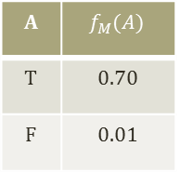
Variable Elimination
Preliminary
$P\left(e | jc,mc\right)=αP\left(e,jc,mc\right)$
Joint probability (e=jc=mc=true)
$P(e,jc,mc,B,A)=αP\left(e\right)\sum_{B}{P\left(b\right)}\sum_{A}{P\left(a | b,e\right)}P\left(jc | a\right)P(mc|a)$
Line up the terms by the topological order
Consider a probability distribution as a function
$f_{E}\left(E=t\right)=0.002$
$=αf_{E}\left(e\right)\sum_{B}{f_{B}\left(b\right)}\sum_{A}{f_{A}(a,b,e)}f_{J}(a)f_{M}(a)$
$=αf_{E}\left(e\right)\sum_{B}{f_{B}\left(b\right)}\sum_{A}{f_{A}(a,b,e)}f_{JM}(a)$
B
E
A
JC
MC
P(E)=0.002
P(B)=0.001
A | P(J|A)
T | 0.90
F | 0.05
B | E | P(A|B,E)
T | T | 0.95
T | F | 0.94
F | T | 0.29
F | F | 0.001
A | $$f_{JM}(A)$$
T | 0.63
F | 0.0005
A | $$f_{J}(A)$$
T | 0.90
F | 0.05
A | $$f_{M}(A)$$
T | 0.70
F | 0.01
A | P(M|A)
T | 0.70
F | 0.01
A | $$f_{M}(A)$$
T | 0.70
F | 0.01
A | $$f_{J}(A)$$
T | 0.90
F | 0.05
A | $$f_{JM}(A)$$
T | 0.63
F | 0.0005

Slide 28
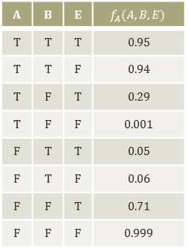
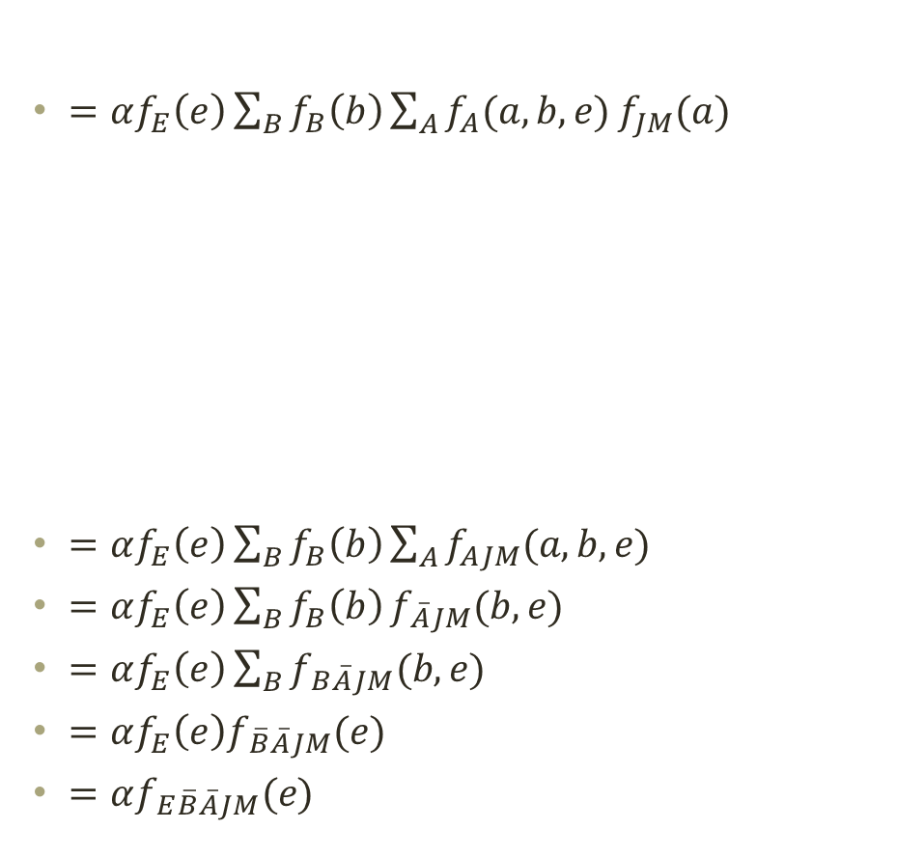
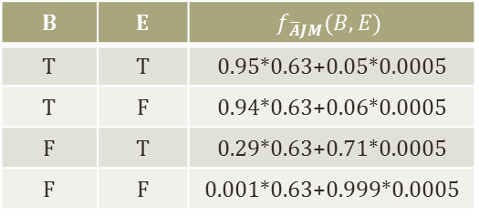
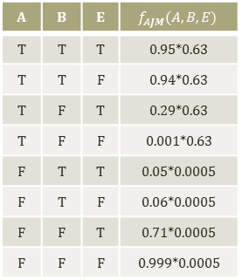
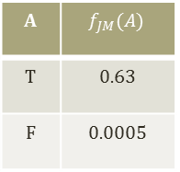
Variable Elimination cont.
$=αf_{E}\left(e\right)\sum_{B}{f_{B}\left(b\right)}\sum_{A}{f_{A}(a,b,e)}f_{JM}(a)$
$=αf_{E}\left(e\right)\sum_{B}{f_{B}\left(b\right)}\sum_{A}{f_{AJM}(a,b,e)}$
$=αf_{E}\left(e\right)\sum_{B}{f_{B}\left(b\right)}f_{\overline{A}JM}(b,e)$
$=αf_{E}\left(e\right)\sum_{B}{f_{B\overline{A}JM}(b,e)}$
$=αf_{E}\left(e\right)f_{\overline{B}\overline{A}JM}(e)$
$=αf_{E\overline{B}\overline{A}JM}(e)$
B
E
A | B | E | $$f_{AJM}(A,B,E)$$
T | T | T | 0.95*0.63
T | T | F | 0.94*0.63
T | F | T | 0.29*0.63
T | F | F | 0.001*0.63
F | T | T | 0.05*0.0005
F | T | F | 0.06*0.0005
F | F | T | 0.71*0.0005
F | F | F | 0.999*0.0005
A | B | E | $$f_{A}(A,B,E)$$
T | T | T | 0.95
T | T | F | 0.94
T | F | T | 0.29
T | F | F | 0.001
F | T | T | 0.05
F | T | F | 0.06
F | F | T | 0.71
F | F | F | 0.999
A | $$f_{JM}(A)$$
T | 0.63
F | 0.0005
A
JC
MC
P(E)=0.002
P(B)=0.001
A | P(J|A)
T | 0.90
F | 0.05
B | E | P(A|B,E)
T | T | 0.95
T | F | 0.94
F | T | 0.29
F | F | 0.001
B | E | $$f_{\overline{A}JM}(B,E)$$
T | T | 0.95*0.63+0.05*0.0005
T | F | 0.94*0.63+0.06*0.0005
F | T | 0.29*0.63+0.71*0.0005
F | F | 0.001*0.63+0.999*0.0005
A | P(M|A)
T | 0.70
F | 0.01

Slide 29

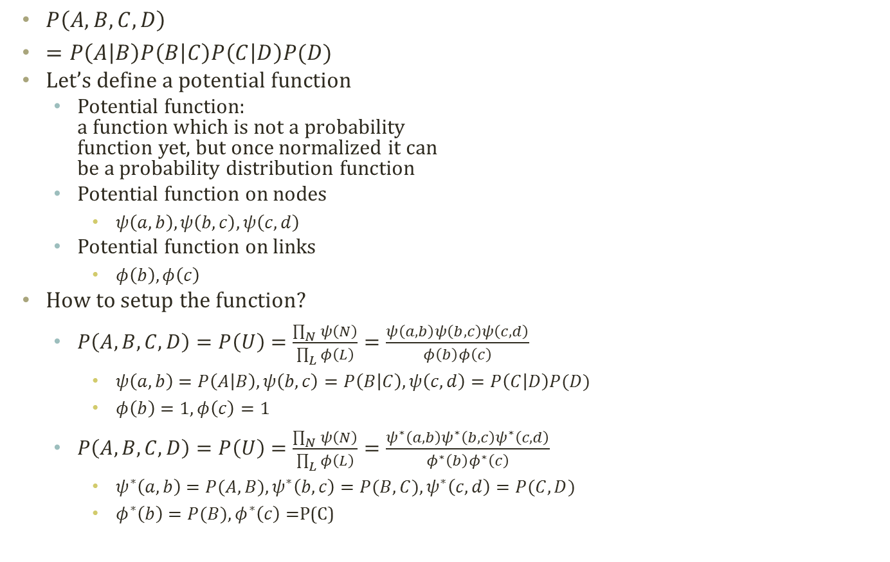
Potential Functions
Clique
Separator
$P\left(A,B,C,D\right)$
$=P\left(A | B\right)P\left(B | C\right)P\left(C | D\right)P(D)$
Let’s define a potential function
Potential function: a function which is not a probability function yet, but once normalized it can be a probability distribution function
Potential function on nodes
$ψ\left(a,b\right),ψ\left(b,c\right),ψ\left(c,d\right)$
Potential function on links
$φ\left(b\right),φ\left(c\right)$
How to setup the function?
$P\left(A,B,C,D\right)=P\left(U\right)=\frac{\prod_{N}{ψ\left(N\right)}}{\prod_{L}{φ\left(L\right)}}=\frac{ψ\left(a,b\right)ψ\left(b,c\right)ψ\left(c,d\right)}{φ\left(b\right)φ\left(c\right)}$
$ψ\left(a,b\right)=P\left(A | B\right),ψ\left(b,c\right)=P\left(B | C\right),ψ\left(c,d\right)=P\left(C | D\right)P(D)$
$φ\left(b\right)=1,φ\left(c\right)=1$
$P\left(A,B,C,D\right)=P\left(U\right)=\frac{\prod_{N}{ψ\left(N\right)}}{\prod_{L}{φ\left(L\right)}}=\frac{ψ^{∗}\left(a,b\right)ψ^{∗}\left(b,c\right)ψ^{∗}\left(c,d\right)}{φ^{∗}\left(b\right)φ^{∗}\left(c\right)}$
$ψ^{∗}\left(a,b\right)=P(A,B),ψ^{∗}\left(b,c\right)=P(B,C),ψ^{∗}\left(c,d\right)=P(C,D)$
$φ^{∗}\left(b\right)=P(B),φ^{∗}\left(c\right)=$P(C)
A
B
C
D
A,B
B
B,C
C
C,D
클릭
분리기
Marginalization is also applicable:
$$ψ\left(w\right)=\sum_{v−w}{ψ\left(v\right)}$$
Constructing a potential of a subset (w) of all variables (v)

Slide 30
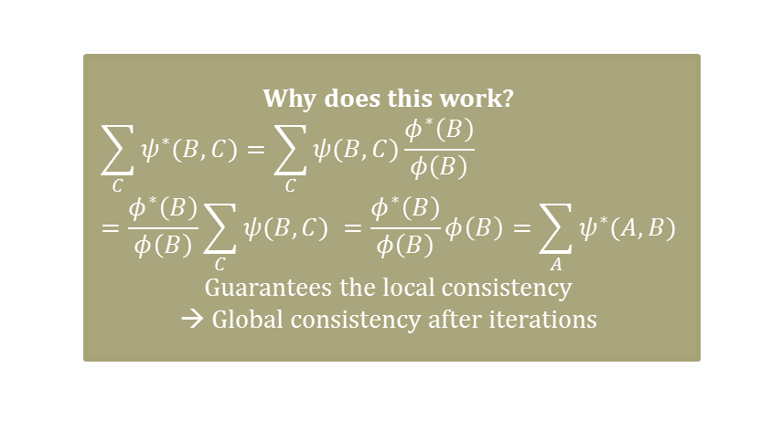
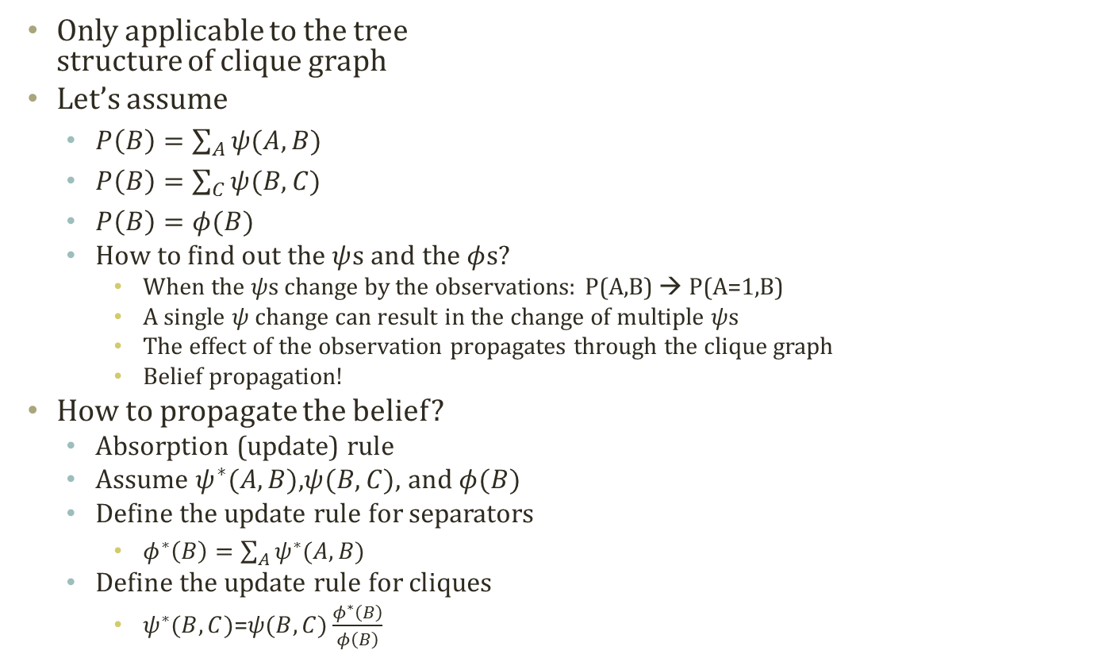
Absorption in Clique Graph
A
B
C
D
Only applicable to the tree structure of clique graph
Let’s assume
$P\left(B\right)=\sum_{A}{ψ(A,B)}$
$P\left(B\right)=\sum_{C}{ψ(B,C)}$
$P\left(B\right)=φ(B)$
How to find out the $ψ$s and the $φ$s?
When the $ψ$s change by the observations: P(A,B) → P(A=1,B)
A single $ψ$ change can result in the change of multiple $ψ$s
The effect of the observation propagates through the clique graph
Belief propagation!
How to propagate the belief?
Absorption (update) rule
Assume $ψ^{∗}(A,B)$,$ψ(B,C)$, and $φ(B)$
Define the update rule for separators
$φ^{∗}\left(B\right)=\sum_{A}{ψ^{∗}(A,B)}$
Define the update rule for cliques
$ψ^{∗}(B,C)$=$ψ(B,C)\frac{φ^{∗}\left(B\right)}{φ\left(B\right)}$
A,B
B
B,C
C
C,D
Why does this work?
$$\sum_{C}{ψ^{∗}(B,C)}=\sum_{C}{ψ(B,C)\frac{φ^{∗}\left(B\right)}{φ\left(B\right)}}=\frac{φ^{∗}\left(B\right)}{φ\left(B\right)}\sum_{C}{ψ(B,C) }=\frac{φ^{∗}\left(B\right)}{φ\left(B\right)}φ\left(B\right)=\sum_{A}{ψ^{∗}(A,B)}$$
Guarantees the local consistency → Global consistency after iterations

Slide 31


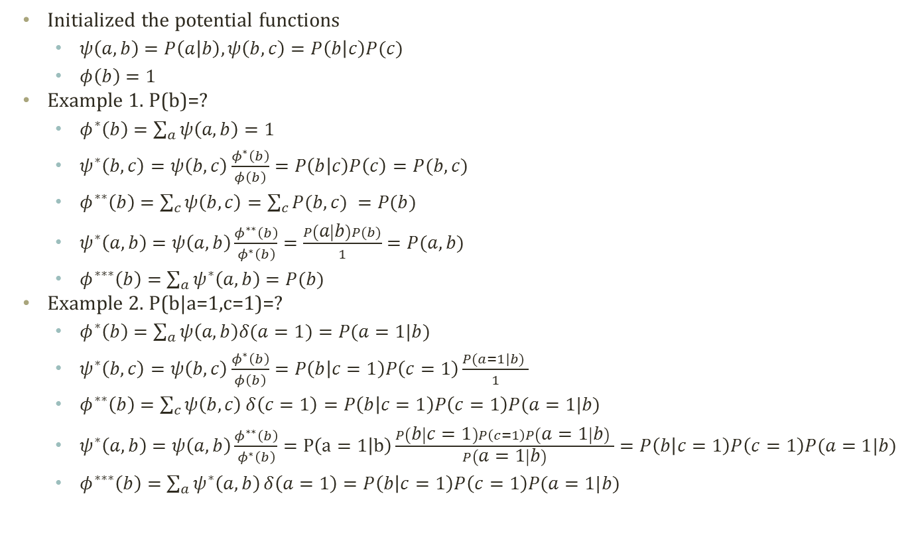



Simple Example of Belief Propagation 신뢰 전파
Initialized the potential functions
$ψ\left(a,b\right)=P\left(a | b\right),ψ\left(b,c\right)=P\left(b | c\right)P(c)$
$φ\left(b\right)=1$
Example 1. P(b)=?
$φ^{∗}\left(b\right)=\sum_{a}{ψ\left(a,b\right)}=1$
$ψ^{∗}\left(b,c\right)=ψ\left(b,c\right)\frac{φ^{∗}\left(b\right)}{φ\left(b\right)}=P\left(b | c\right)P\left(c\right)=P(b,c)$
$φ^{∗∗}\left(b\right)=\sum_{c}{ψ\left(b,c\right)}=\sum_{c}{P(b,c) }=P(b)$
$ψ^{∗}\left(a,b\right)=ψ\left(a,b\right)\frac{φ^{∗∗}\left(b\right)}{φ^{∗}\left(b\right)}=\frac{P\left(a | b\right)P(b)}{1}=P(a,b)$
$φ^{∗∗∗}\left(b\right)=\sum_{a}{ψ^{∗}\left(a,b\right)}=P(b)$
Example 2. P(b|a=1,c=1)=?
$φ^{∗}\left(b\right)=\sum_{a}{ψ\left(a,b\right)δ(a=1)}=P(a=1|b)$
$ψ^{∗}\left(b,c\right)=ψ\left(b,c\right)\frac{φ^{∗}\left(b\right)}{φ\left(b\right)}=P\left(b | c=1\right)P\left(c=1\right)\frac{P(a=1|b) }{1}$
$φ^{∗∗}\left(b\right)=\sum_{c}{ψ\left(b,c\right)}δ\left(c=1\right)=P\left(b | c=1\right)P\left(c=1\right)P(a=1|b)$
$ψ^{∗}\left(a,b\right)=ψ\left(a,b\right)\frac{φ^{∗∗}\left(b\right)}{φ^{∗}\left(b\right)}=P\left(a=1 | b\right)\frac{P\left(b | c=1\right)P\left(c=1\right)P\left(a=1 | b\right) }{P\left(a=1 | b\right)}=P\left(b | c=1\right)P\left(c=1\right)P(a=1|b)$
$φ^{∗∗∗}\left(b\right)=\sum_{a}{ψ^{∗}\left(a,b\right)}δ\left(a=1\right)=P\left(b | c=1\right)P\left(c=1\right)P(a=1|b)$
A
B
C
베이지안 네트워크
1) $φ^{∗}\left(b\right)$
2) $ψ^{∗}\left(b,c\right)$
4) $ψ^{∗}\left(a,b\right)$
3) $φ^{∗∗}\left(b\right)$
5) $φ^{∗∗∗}\left(b\right)$
A,B
B
B,C
클릭 그래프

Slide 32
Another Example of Bayes Net.
P(Q=peace)=0.6
P(L=peace)=0.4
Q
L
P(S=y|L=p)=0.8
P(S=y|L=w)=0.3
P(F=y|Q=p)=0.8
P(F=y|Q=w)=0.1
F
B
G
S
P(G=u|L=p,Q=p)=0.3
P(G=u|L=p,Q=w)=0.8
P(G=u|L=w,Q=p)=0.1
P(G=u|L=w,Q=w)=0.2
P(G=0|L=p,Q=p)=0.6
P(G=0|L=p,Q=w)=0.1
P(G=0|L=w,Q=p)=0.2
P(G=0|L=w,Q=w)=0.2
P(B=r|L=p,Q=p)=0.2
P(B=r|L=p,Q=w)=1
P(B=r|L=w,Q=p)=1
P(B=r|L=w,Q=w)=1
H
P(I=y|G=0,H=y)=0
P(I=y|G=d,H=y)=0
P(I=y|G=u,H=y)=0
P(I=y|G=0,H=n)=0.3
P(I=y|G=d,H=n)=0.1
P(I=y|G=u,H=n)=1
P(H=y|B=r,F=y)=0.4
P(H=y|B=r,F=n)=1
P(H=y|B=s,F=n)=0.5
P(H=y|B=s,F=y)=0.1
I
Given that 1) my clan is in war, 2) goat gain is steady, and 3) farming goes on, will I face hunger?
L={peace,war}, Q={peace, war}, F={yes,no},B={run, stay}, G={up,0,down},S={yes,no},H={yes,no},I={yes,no}
My clan (Q) vs. Opponent Clan (L) dispute over Goats (G)
Smoke (S) lets know the opponent strategy
Farming (F) and Hunting (B) are the major sources of resources
Hunger (H) should be avoided, and the improvement of life quality (I) should be pursued.

Slide 33
Moralization and Triangulation
Q
L
F
B
G
S
H
I
Q
L
Q
L
F
B
G
S
F
B
G
S
H
H
I
I
Moralized Network
Triangulated Network
Moralization
Marry the parents
Drop the directionality
Triangulation 삼각화
Add a chord link for a loop whose length is over four
Chord: a link joining two non-consecutive nodes of a loop
Loop:
Q→B→H→G→Q
L→B→H→G→L
and one more?

Slide 34
Clique Graph and Junction Tree
Q
L
F
B
G
S
H
I
Triangulated Network
LQBG
LQBG
QB
L
L
QBG
QBG
QFBH
QBH
HBQG
LS
QFBH
QBH
HBQG
LS
GH
GH
IGH
IGH
Clique Graph
Junction Tree
Clique graph
Clique
Maximal cliques in the triangulated network
Separator
Intersecting nodes of two identified cliques in the triangulated network
Junction Tree
Sub-graph of clique graph
Tree structured
Contains all nodes in clique graph
Weight of an edge in the clique graph == # of random variables associated with the edge
Maximum weight spanning tree == junction tree

Slide 35
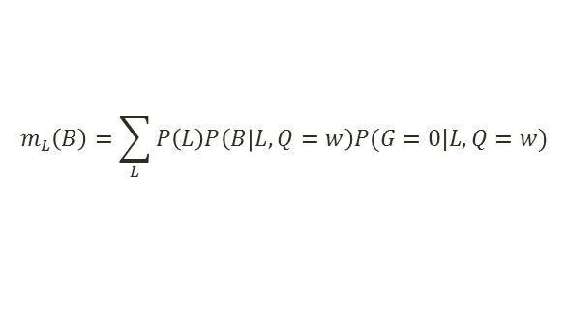
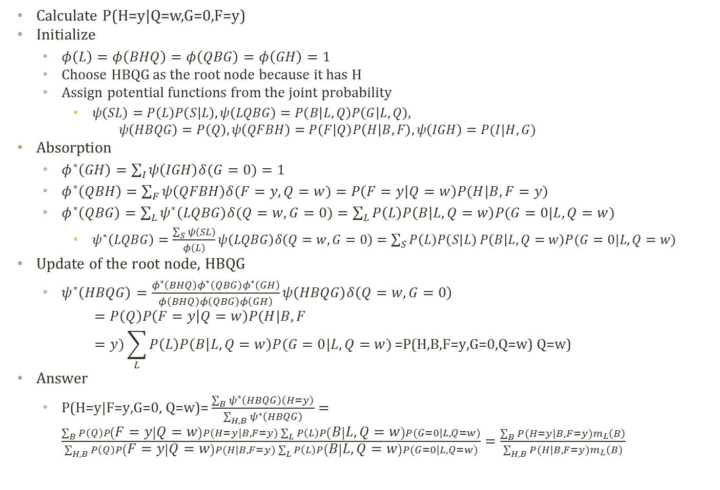
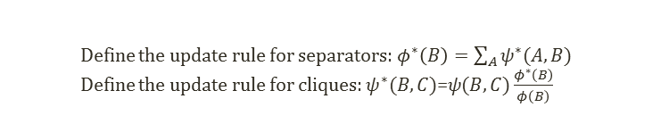
Junction Tree Algorithm Example
Define the update rule for separators: $φ^{∗}\left(B\right)=\sum_{A}{ψ^{∗}(A,B)}$
Define the update rule for cliques: $ψ^{∗}(B,C)$=$ψ(B,C)\frac{φ^{∗}\left(B\right)}{φ\left(B\right)}$
$$m_{L}\left(B\right)=\sum_{L}{P\left(L\right)P\left(B | L,Q=w\right)P(G=0|L,Q=w)}$$
LQBG
QBG
L
QFBH
QBH
HBQG
LS
GH
Calculate P(H=y|Q=w,G=0,F=y)
Initialize
$φ\left(L\right)=φ\left(BHQ\right)=φ\left(QBG\right)=φ\left(GH\right)=1$
Choose HBQG as the root node because it has H
Assign potential functions from the joint probability
$ψ\left(SL\right)=P\left(L\right)P\left(S | L\right),ψ\left(LQBG\right)=P\left(B | L,Q\right)P\left(G | L,Q\right),$ $ψ\left(HBQG\right)=P\left(Q\right),ψ\left(QFBH\right)=P\left(F | Q\right)P\left(H | B,F\right),ψ\left(IGH\right)=P(I|H,G)$
Absorption
$φ^{∗}\left(GH\right)=\sum_{I}{ψ\left(IGH\right)δ(G=0)}=1$
$φ^{∗}\left(QBH\right)=\sum_{F}{ψ\left(QFBH\right)δ(F=y,Q=w)}=P\left(F=y | Q=w\right)P(H|B,F=y)$
$φ^{∗}\left(QBG\right)=\sum_{L}{ψ^{∗}\left(LQBG\right)δ(Q=w,G=0)}=\sum_{L}{P\left(L\right)P\left(B | L,Q=w\right)P(G=0|L,Q=w)}$
$ψ^{∗}\left(LQBG\right)=\frac{\sum_{S}{ψ\left(SL\right)}}{φ\left(L\right)}ψ\left(LQBG\right)δ\left(Q=w,G=0\right)=\sum_{S}{P\left(L\right)P\left(S | L\right)}P\left(B | L,Q=w\right)P(G=0|L,Q=w)$
Update of the root node, HBQG
$ψ^{∗}\left(HBQG\right)=\frac{φ^{∗}\left(BHQ\right)φ^{∗}\left(QBG\right)φ^{∗}\left(GH\right)}{φ\left(BHQ\right)φ\left(QBG\right)φ\left(GH\right)}ψ\left(HBQG\right)δ\left(Q=w,G=0\right)$ $=P\left(Q\right)P\left(F=y | Q=w\right)P(H|B,F=y)\sum_{L}{P\left(L\right)P\left(B | L,Q=w\right)P(G=0|L,Q=w)}\text{=}\text{P}\text{(}\text{H}\text{,}\text{B}\text{,}\text{F}\text{=}\text{y}\text{,}\text{G}\text{=0,}\text{Q}\text{=}\text{w}\text{) }\text{Q}\text{=}\text{w}\text{)}$
Answer
$\text{P}\text{(}\text{H}\text{=}\text{y}\text{|}\text{F}\text{=}\text{y}\text{,}\text{G}\text{=0, }\text{Q}\text{=}\text{w}\text{)=}\frac{\sum_{B}{ψ^{∗}\left(HBQG\right)\left(H=y\right)}}{\sum_{H,B}{ψ^{∗}\left(HBQG\right)}}=\frac{\sum_{B}{P\left(Q\right)P\left(F=y | Q=w\right)P(H=y|B,F=y)\sum_{L}{P\left(L\right)P\left(B | L,Q=w\right)P(G=0|L,Q=w)}}}{\sum_{H,B}{P\left(Q\right)P\left(F=y | Q=w\right)P(H|B,F=y)\sum_{L}{P\left(L\right)P\left(B | L,Q=w\right)P(G=0|L,Q=w)}}}=\frac{\sum_{B}{P(H=y|B,F=y)m_{L}\left(B\right)}}{\sum_{H,B}{P(H|B,F=y)m_{L}\left(B\right)}}$
IGH
Q
L
F
B
G
S
H
I

Slide 36


















Junction Tree Algorithm in Diagram
Belief Network
Graph Transformation
Junction Tree
Initialization
Inconsistent Junction Tree
Message Passing
Consistent Junction Tree
Marginalization
$$ψ\text{(}\text{LQBG}\text{)}$$
$$ψ\text{(}\text{LQBG}\text{)}$$
P(V)
$$φ\left(\text{QBG}\right)$$
$$φ\left(L\right)$$
$$φ\left(\text{QBG}\right)$$
$$φ\left(L\right)$$
$$ψ\text{(}\text{QFBH}\text{)}$$
$$φ\left(\text{QB}H\right)$$
$$ψ\text{(}\text{HBQG}\text{)}$$
$$ψ\text{(}\text{LS}\text{)}$$
$$ψ\text{(}\text{QFBH}\text{)}$$
$$φ\left(\text{QB}H\right)$$
$$ψ\text{(}\text{HBQG}\text{)}$$
$$ψ\text{(}\text{LS}\text{)}$$
$$φ\left(\text{GH}\right)$$
$$φ\left(\text{GH}\right)$$
$$ψ\text{(}\text{IGH}\text{)}$$
$$ψ\text{(}\text{IGH}\text{)}$$
Collection Phase
Distribution Phase
Iterative run of
Collection phase: going up to the root
Distribution phase: going down to the leaf
Messages are absorbed in the process
Stop when the queried probability is answered
You may have to perform summation on the joint probability obtained by the chosen potential function

Slide 37
Acknowledgement
This slideset is greatly influenced
By Prof. Eric Xing at CMU
By Prof. Chris Williams at Univ. of Edinburgh

Slide 38
Further Readings
Bishop Chapter 8
Murphy Chapter 20
Barber Chapter 4, 5, 6

